Slide 1
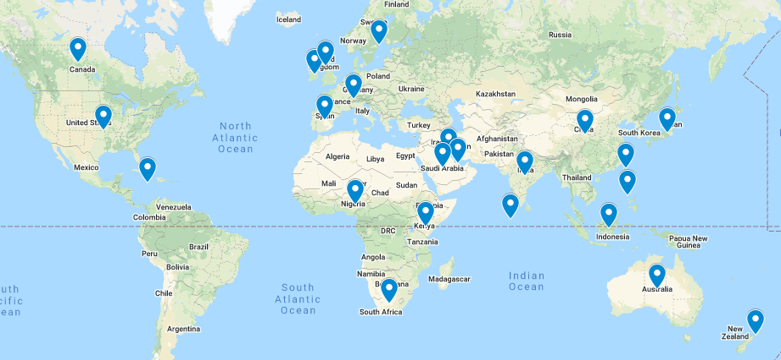
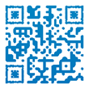
IACRN Membership, Marketing and Communication Committee
The MMC supports the mission and vision of IACRN through the management of internal and external communications, membership promotions, and marketing of the organization.
FUTURE GOALS: Grow membership to 550 by 2023 conference Enhance Social Media globally Establish Business LinkedIn Account
Committee Members
IACRN Membership
Priorities Work Group Members
Chair: M. Terry Jeffs - Washington, DC
Board Liaison: Doyle Bosque – Texas
Melanie Arnold - Oklahoma
Akhona Kamalu - South Africa
Brian Beardslee - Massachusetts
Jane Govender – New Zealand
Gordon Hill - Scotland
Alison Hyde - New York
Loveline Mbah - Michigan
Catherine Ricciardi - Massachusetts
Dixie Thompson - Utah
Beatrice Washi Kimono - Uganda
Members: 470 Represented Countries: 23 & growing
Leader: Candi Barlow - Oklahoma
Liaison: M. Terry Jeffs - Washington, DC
Melanie Arnold - Oklahoma
Denise Brigham – North Carolina
Akhona Kamalu - South Africa
Lisa Marsh - Texas
Patty Mendoza – Texas
Accomplishments/ Outcomes
Conducted Member Survey
SWOT Analysis
Promoted Clinical Trials Day Campaigns
Promoted Why We Do Research Campaigns
Promoted International Nurses Day
T-shirt Design Contest
Network and Nosh Virtual Cocktail Gatherings
Created Infographic about CRNs & IACRN
Committee Meetings via Zoom
Second week of each month
11am-12pm ET
Email: M. Terry Jeffs jeffsm@georgetown.edu
Your voice matters - Come join our dynamic team!
Engage with IACRN Please click the audio icon to hear how you can join the MMC!
1440 followers
#IACRN22
2174 followers
731 followers
72 followers
Enhancing clinical research quality and safety through specialized nursing practice.

